Slide 1
BITS Pilani presentation
K.Anantharaman
Faculty CS Department
kanantharaman@wilp.bits-pilani.ac.in
30/8/22
30/8/22
S1-22_SEZG544 - Agile Software Process

Slide 2
SE ZG544 , Agile Software Process
Lecture No. 2 – Module-2 : Agile Software Development
30/8/22
S1-22_SEZG544 - Agile Software Process

Slide 3
Module-2 Topics
Project Life Cycle Models
Iterative, Incremental and (Adaptive or Agile) Approaches
Early Agile Models
Popular Agile Methods
30/8/22
S1-22_SEZG544 - Agile Software Process

Slide 4
Project Life cycle models
30/8/22
S1-22_SEZG544 - Agile Software Process

Slide 5
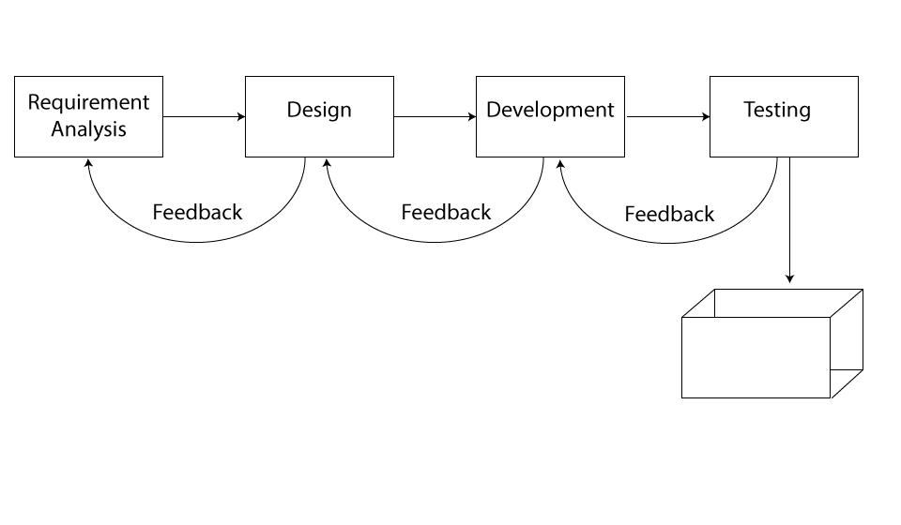
Predictive Project Development Life Cycle
Fully Plan-Driven aka Waterfall - Risky Invite Failure
Goal, Characteristics: Cost, Requirements-Fixed,Single Delivery
Source : https://www.izenbridge.com/blog/project-management-life-cycle-iterative-adaptive/
30/8/22
S1-22_SEZG544 - Agile Software Process

Slide 6
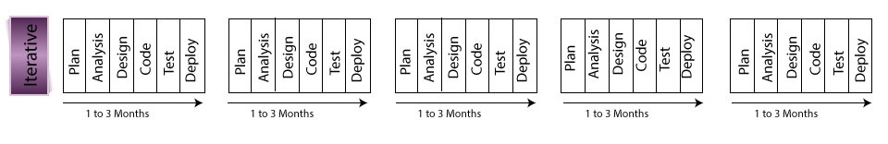
Iterative & Incremental Project Development Life Cycle
Plan
Goal, Characteristics:
Iteration Model: Accuracy/Correctness, Single Delivery
Incremental: Speed, Multiple Deliveries
Requirements-Dynamic
Iteration life cycle: Product Increment/output may not be usable
Example: Customized outfit/coat, Website
Incremental life cycle: Product Increment/output is usable
Example: Visit to a restaurant
Source: https://www.izenbridge.com//
30/8/22
S1-22_SEZG544 - Agile Software Process

Slide 7
Q&A
Q1,Q2
https://forms.gle/E8rdswFxp6B2pWfD9
https://forms.gle/A9W5ikfCJPaT5tbg8
30/8/22
S1-22_SEZG544 - Agile Software Process

Slide 8
Agile Life Cycle Models
Iterative
Flow-Based
30/8/22
S1-22_SEZG544 - Agile Software Process

Slide 9
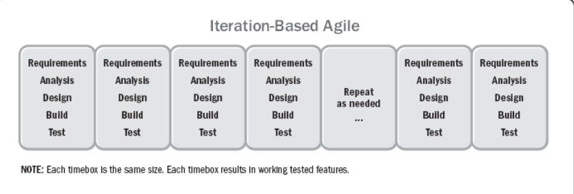
Agile/Adaptive Life Cycle-Iteration Based Agile
Plan
Fixed Time box : 1-4 weeks equal duration for each iteration Goals and Characteristics: Value, Multiple deliveries
Ref: Agile Practice Guide (ENGLISH) by Project Management Institute Published by Project Management Institute, 2017 (Agile methodologies)I
30/8/22
S1-22_SEZG544 - Agile Software Process

Slide 10
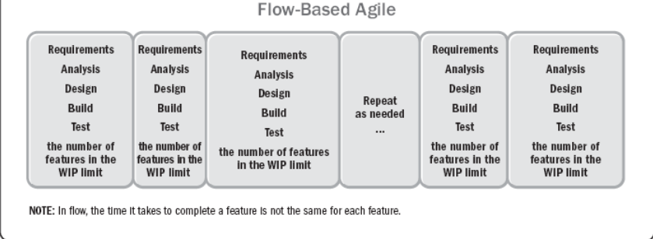
Agile/Adaptive Life Cycle-Flow-based Based Agile
The project life cycle that is iterative and incremental
Plan
Variable Time Box : Goals and Characteristics: Value, Multiple deliveries
Ref: Agile Practice Guide (ENGLISH) by Project Management Institute Published by Project Management Institute, 2017 (Agile methodologies)I
30/8/22
S1-22_SEZG544 - Agile Software Process

Slide 11
Popular Early* Iterative
and Agile Models
* Year ~2000 before
Iterative
Spiral
RUP
Agile
DSDM
FDD
Crystal
30/8/22
S1-22_SEZG544 - Agile Software Process

Slide 12
Q&A
Q3,Q4,Q5
https://forms.gle/bz3784DRQYHD5BnN9
https://forms.gle/TZpHt55eRhKijnZT9
https://forms.gle/7XCdp9E7yr9ABG2r8
30/8/22
S1-22_SEZG544 - Agile Software Process

Slide 13
Project Classifications/Decision making models
30/8/22
S1-22_SEZG544 - Agile Software Process

Slide 14
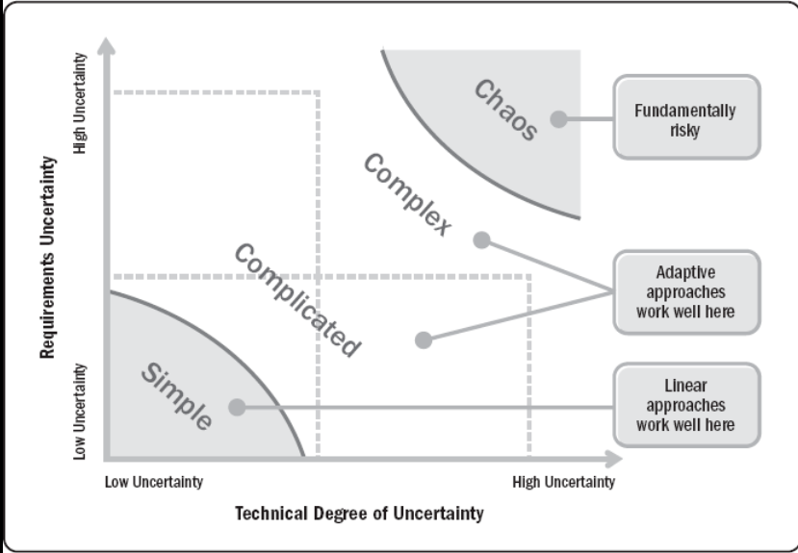
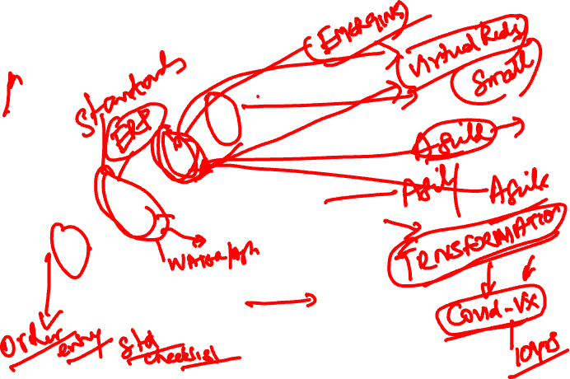
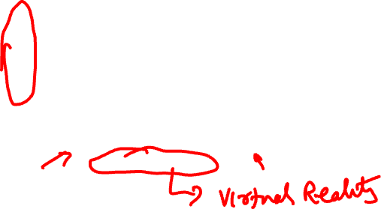
Agile Suitability - Project Environment
Stacey’s Complexity Model
Ref: Agile Practice Guide (ENGLISH) by Project Management Institute Published by Project Management Institute, 2017 (Agile methodologies)
30/8/22
Agile Software Process SE ZG544 S1-22-23

Slide 15
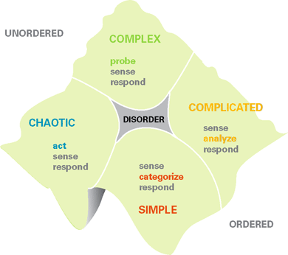
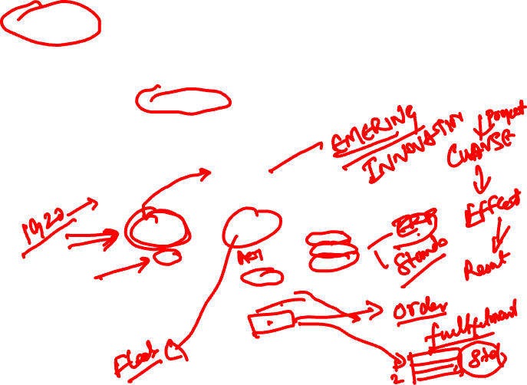
Cynefin framework - A Leader’s Framework for Decision Making
Pronounced as: kun-ev-in
Developed in the early 2000s by David Snodown
Emergent
Good/Standard
Practice
Novel
Best Practice
30/8/22
Agile Software Process SE ZG544 S1-22-23

Slide 16
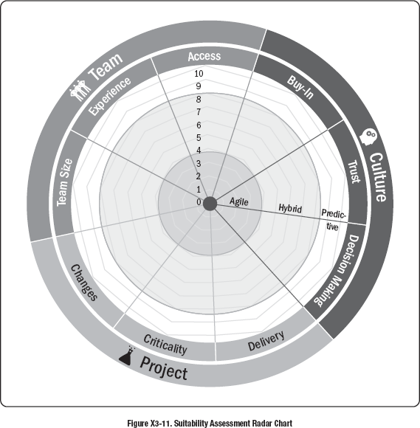
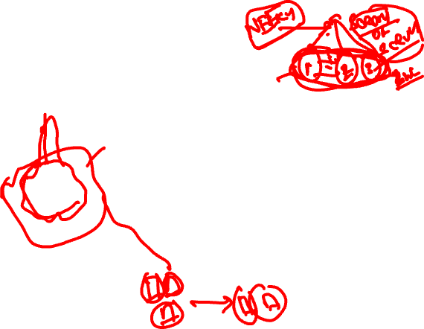
Agile Suitability Filter
Attributes | Assessment
Buy-In | 0-Yes, 5-Partial, 10-No
Trust | 0-Yes, 5-Probabily, 10-No
Decision Making | 0-Yes, 5-Probably, 10-Unlikely
Incremental Delivery | 0-Yes, 5-Maybe/Sometimes, 10-Unlikely
Criticality | 0-Low, 5-Medium, 10-High
Changes | 0-High, 5-Medium, 10-Low
Team Size | 1-Small (<10), 5-Medium (>80), 10- Large (>200)
Experience | 0-Yes, 5-Partial, 10-No
Access to business Info/Project Info | 0-Yes, 5-Partial, 10-No
30/8/22
Agile Software Process SE ZG544 S1-22-23

Slide 17
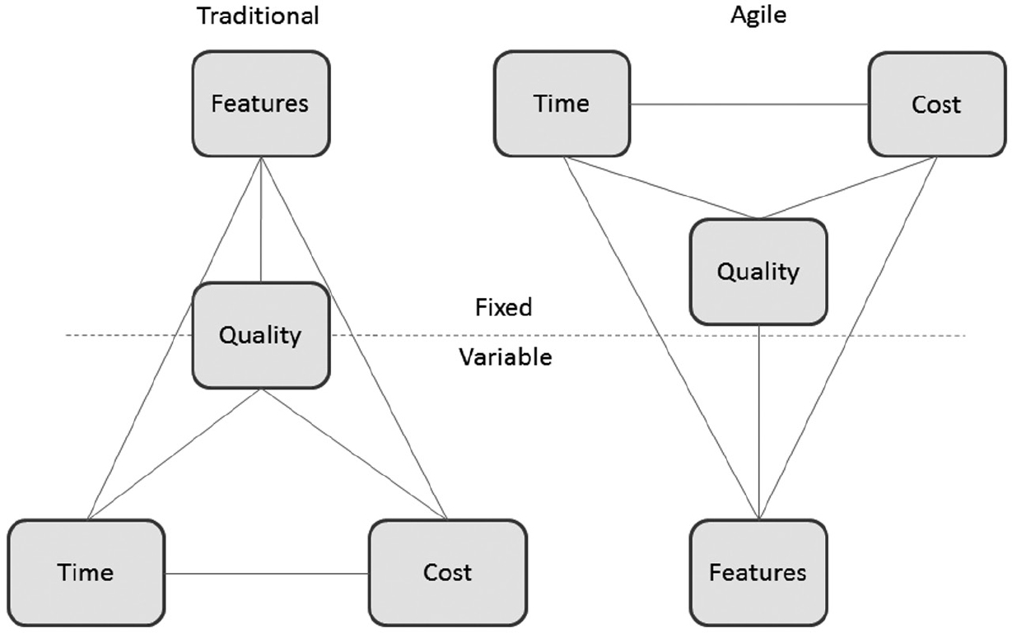
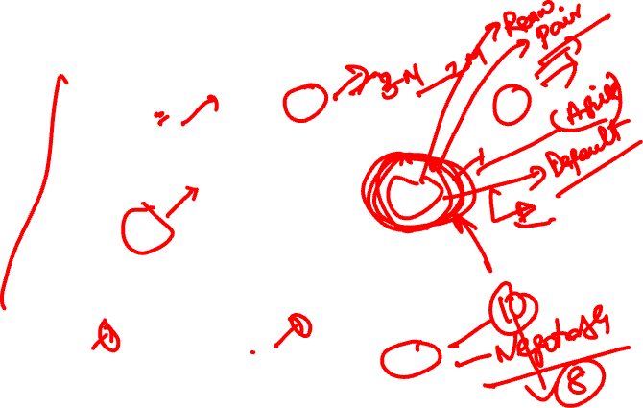
The “IRON” Triangle – Triple Constraints
Ref: Agile Foundations - Principles, practices and frameworks by Peter Measey
30/8/22
Agile Software Process SE ZG544 S1-22-23

Slide 18
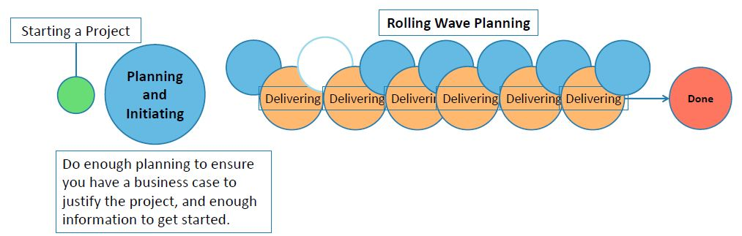
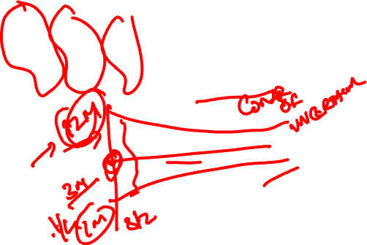
Rolling Wave Planning or Progressive Elaboration
https://www.simplilearn.com/adaptive-planning-part-1-tutorial
30/8/22
Agile Software Process SE ZG544 S1-22-23

Slide 19
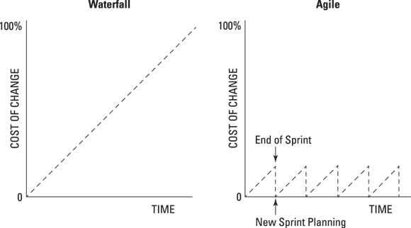
Cost of Changes:
Agile vs Traditional Development
30/8/22
Agile Software Process SE ZG544 S1-22-23

Slide 20
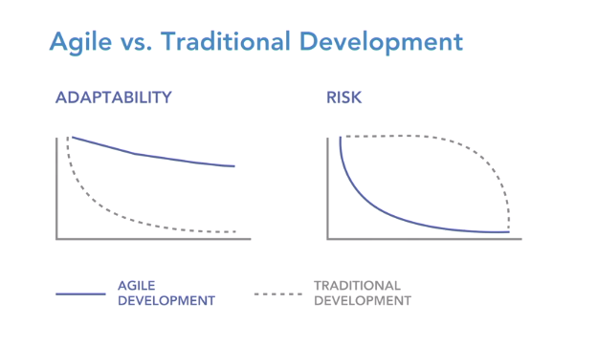
Adaptability and Risk
Agile vs Traditional Development
30/8/22
Agile Software Process SE ZG544 S1-22-23

Slide 21
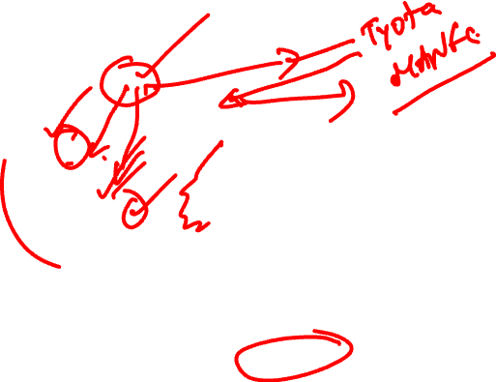
Popular Agile Methods
They all have one important thing in common:
they focus on changing your team’s mindset.
30/8/22
S1-22_SEZG544 - Agile Software Process

Slide 22
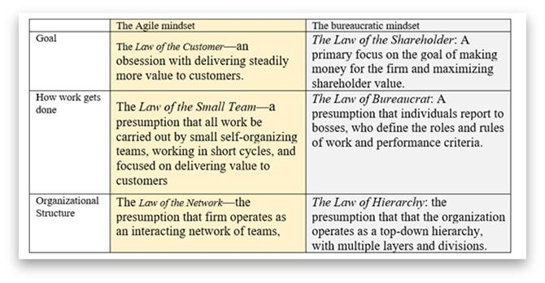
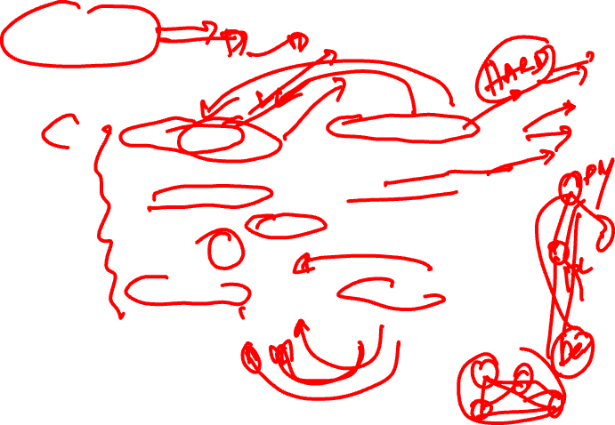
Mindset
Source: https://www.forbes.com/sites/stevedenning/2019/08/13/understanding-the-agile-mindset/?sh=5a66a5545c17

Slide 23

Q&A
Q6,Q7,Q8
https://forms.gle/9SUn7mtfuxcZ3kZUA
https://forms.gle/2f6AqYXnGMynNbKdA
https://forms.gle/3USQSAg2vKScGPZf7
30/8/22
S1-22_SEZG544 - Agile Software Process

Slide 24
End Contact Session-2
30/8/22
S1-22_SEZG544 - Agile Software Process

Slide 25
Module-2 Additional Notes
30/8/22
S1-22_SEZG544 - Agile Software Process

Slide 26
Life Cycle
The sequence of actions that must be performed in order to build a software system
Ideally thought to be a linear sequence: plan, design, build, test, deliver
This is the waterfall model
Realistically an iterative process
Iterative, Incremental, Agile Process
30/8/22
S1-22_SEZG544 - Agile Software Process

Slide 27
Predictive Project Development Life Cycle
(Fully Plan-Driven aka Waterfall)
A more traditional approach, with the bulk of planning occurring upfront, then executing in a single pass; a sequential process
Requirements/Scope is fixed
Single delivery
Goal: Manage Cost
Minimal feedback changes
Team is matured in estimation, technology etc..
Project governance model exists
Don’t expect long feedback cycle, If this happens, this lifecycle not suitable for the project
Plan
Source : https://www.izenbridge.com/blog/project-management-life-cycle-iterative-adaptive/
30/8/22
S1-22_SEZG544 - Agile Software Process

Slide 28
Iterative Project Development Life Cycle
Iterative development is when an attempt is made to develop a product with basic features, which then goes through a refinement process successively to add to the richness in features.
Plan
Goal: Correctness of Solution
Repeat until Correct
Show and receive feedback
Add richness or features
Single Final Delivery
Deliver result at the end of each iteration.
Result may not be usable
E.g. 1 year project divided into 3 to 4 iterations
Ref: https://www.izenbridge.com//
30/8/22
S1-22_SEZG544 - Agile Software Process

Slide 29
Examples of Iterative Development
When you are getting a customized coat made
You may be required to go for a trail to check for the fitting.
Even though the you may find the coat fitting well, you may not be able to use it as it has not been finished.
The fitting test was to give you an idea of the final product, which may not be ready for your consumption.
This is an example of iterative prototyping.
Developing a Website
Develop a prototype of the Website with basic functionality
Demo to Customer and receive feedback
Add to the richness or feature to the product in subsequent iteration
Source: https://www.izenbridge.com//
30/8/22
S1-22_SEZG544 - Agile Software Process

Slide 30
Incremental Life Cycle
In an incremental approach, one aims to build pieces of program/product that is complete in features and richness. Product increment is usable.
In this case, each functionality is built to its fullest and additional functionalities are added in an incremental fashion.
Plan
Example: You can compare this to a visit to restaurant. You get served starters first and on completion of its main course and then dessert. You get served incrementally and you consume it.
Source: https://www.izenbridge.com//
30/8/22
S1-22_SEZG544 - Agile Software Process

Slide 31
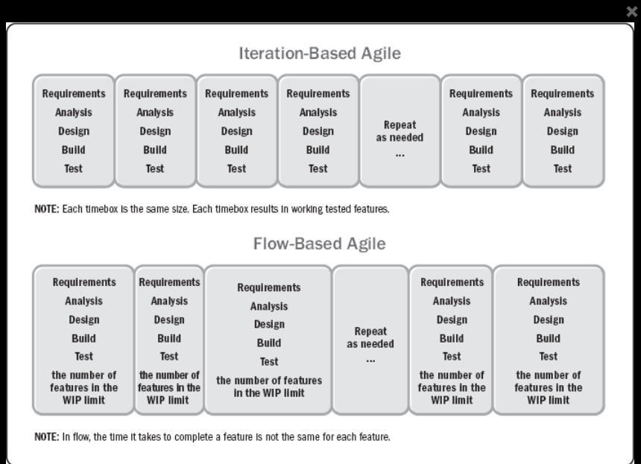
Agile/Adaptive Life Cycle
The project life cycle that is iterative and incremental
Time Box
Fixed Time box : 1-4 weeks equal duration for each iteration
Plan
Limit WIP (work in Progress)
Optimize the flow
Ref: Agile Practice Guide (ENGLISH) by Project Management Institute Published by Project Management Institute, 2017 (Agile methodologies)I
30/8/22
S1-22_SEZG544 - Agile Software Process

Slide 32
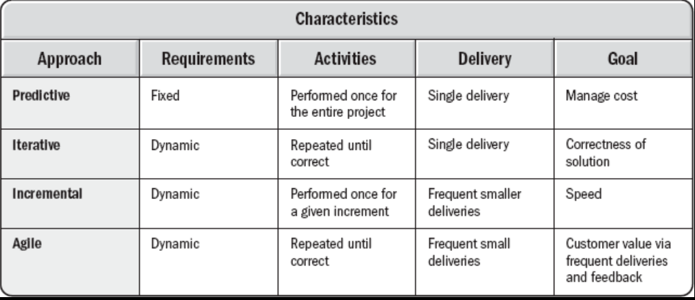
Project Life Cycles Characteristics
It should be emphasized that development life cycles are complex and multidimensional.
Often, the different phases in a given project employ different life cycles, just as distinct projects within a given program may each be executed differently.
Ref: Agile Practice Guide (ENGLISH) by Project Management Institute Published by Project Management Institute, 2017 (Agile methodologies)I
30/8/22
S1-22_SEZG544 - Agile Software Process

Slide 33
Delivery Environments and Agile Suitability
Delivery Environments and Agile Suitability
30/8/22
Agile Software Process SE SG544 S1-22-23

Slide 34
Delivery Environments
The environment within which Project/Product delivery will occur should largely drive the delivery and governance framework(s) that will be implemented.
For example, in a delivery environment where high variability is likely to be encountered (like IT product development), an Agile framework would be suited
In an environment where variability is likely to be low, a more defined process may be more suited (like ‘Waterfall’).
Ref: Agile Foundations - Principles, practices and frameworks by Peter Measey
30/8/22
Agile Software Process SE SG544 S1-22-23

Slide 35
Understanding the Delivery Environments:
Stacey’s Complexity Model
Simple Environment: Use defined Process like Waterfall
Complicated/Complex/Anarchy Environment: Use Empirical process like Agile. Example: New IT product development
When trying to understand types of environments, it is important to take into account the amount of innovation that is being sought or considered for a new product or service. As the level of innovation increases, so does the move towards complexity, and a high variability is likely to be present.
Ref: Agile Foundations - Principles, practices and frameworks by Peter Measey
30/8/22
Agile Software Process SE SG544 S1-22-23

Slide 36
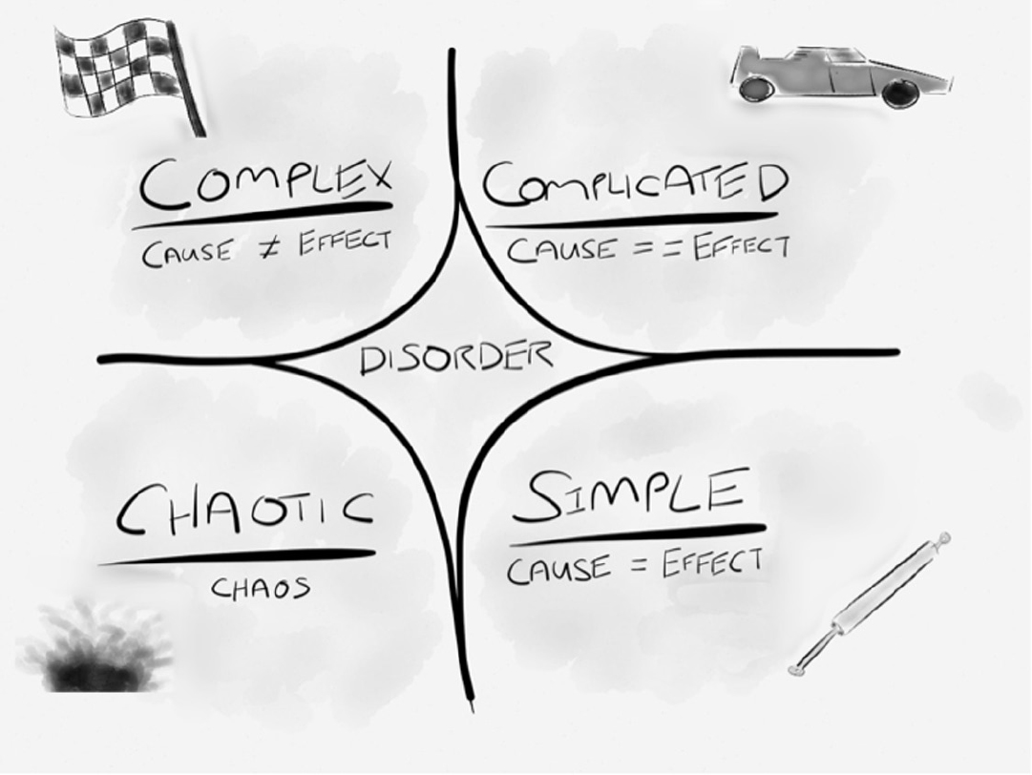
Cynefin Framework for Decision Making
The Cynefin framework (Snowdon and Boone, 2007) gives an alternative framework for determining and understanding simple, complicated and complex environments
The central idea of the framework is to offer decision-makers a “sense of place” to view their perceptions in dealing with a situation or problem. Not all situations are equal, and this framework helps to define which response is required for a given situation or problem.
https://txm.com/making-sense-problems-cynefin-framework/
30/8/22
Agile Software Process SE SG544 S1-22-23

Slide 37
Cynefin identifies five domains:
Simple (obvious) domain:
In this domain the relationship between cause and effect is obvious and therefore it is relatively easy to predict an outcome. In this domain predictive planning works well as everything is pretty well understood. Teams can define up front how best to deliver a product, and they can then create a defined approach and plan. The Waterfall model works well in these types of environments with little variability.
Complicated domain
In this domain, the relationship between cause and effect becomes less obvious; however, after a period of analysis it should generally be possible to come up with a defined approach and plan. Such a plan will normally include contingency to take into account the fact that the analysis may be flawed by a certain amount. Again, the Waterfall model is suitable for this environment as there is an element of definition up front; however, a more empirical process, like Agile, may be more suited.
https://txm.com/making-sense-problems-cynefin-framework/
30/8/22
Agile Software Process SE SG544 S1-22-23

Slide 38
Cynefin identifies five domains:
Complex domain
In this domain the relationship between cause and effect starts to break down as there tend to be many different factors that drive the effect. While it may be possible to identify retrospectively a relationship between cause and effect, the cause of an effect today may be different to the cause of the same effect tomorrow. Creating a defined up-front approach and plan is not effective within this domain and therefore an Agile way of working is recommended.
Chaotic domain
In this domain, there is no recognizable relationship between cause and effect at all, making it impossible to define an approach up front or to plan at all. Instead, teams must perform experiments (e.g. prototyping, modelling) with the aim to move into one of the other less chaotic domains. An Agile approach can work in this domain, for example Kanban which does not require up-front plans.
Disorder
Being in this environment means that it is impossible to determine which domain definition applies. This is the most risky domain as teams tend to fall into their default way of working, which may prove unsuitable for what they are trying to achieve.
https://txm.com/making-sense-problems-cynefin-framework/
30/8/22
Agile Software Process SE SG544 S1-22-23

Slide 39
A Note on
Cynefin identifies five domains:
During a product’s development and evolution there may be elements of delivery spread across all the Cynefin domains at the same time.
There may be aspects of a large system that are simple, while others may be in the complicated domain; and there could also be areas where innovation is necessary and which require a move towards the complex or even towards the chaotic domain.
https://txm.com/making-sense-problems-cynefin-framework/
30/8/22
Agile Software Process SE SG544 S1-22-23

Slide 40
Some Popular Iteration Models
Some Popular Iteration Models
30/8/22
S1-22_SEZG544 - Agile Software Process

Slide 41
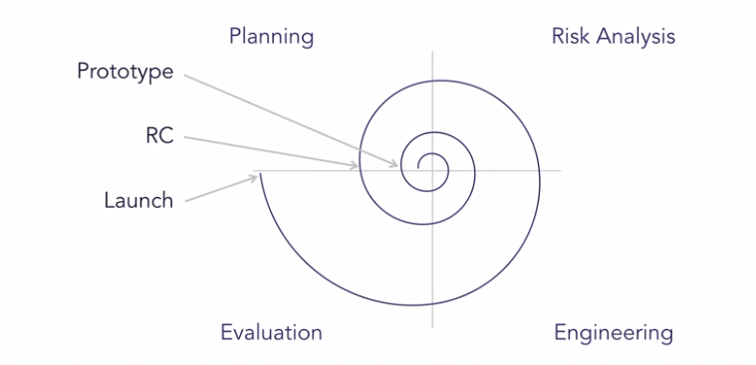
Spiral Risk Driven Customer driven Planning
Developed by Barry Boehm, 1986.
Easier management of risks (Theme)
Mix of water fall and iterations
Y-Axis represents Cost
X-Axis represents Review
Prototype-1, Prototype-2 ….
Operational Prototype
Final Release
Four Phases
Planning: Requirements Identification and Analysis
Risk Analysis: Risk identification, Prioritization and Mitigation
Engineering: Coding, Testing and Deployment
Evaluation: Review and plan for next iteration
30/8/22
Ref: Agile Software Development with Shashi Shekhar,LinkedIn Learning
S1-22_SEZG544 - Agile Software Process

Slide 42
Rational Unified Process (RUP)
1990s, Rational Software developed the Rational Unified Process as a software process product.
IBM acquired Rational software in 2006 (era of OOAD,UML)
Rational Unified Process, or RUP, was an attempt to come up with a comprehensive iterative software development process.
RUP is essentially a large pool of knowledge. RUP consists of artifacts, processes, templates, phases, and disciplines.
RUP is defined to be a customizable process that would work for building small, medium, and large software systems.
Ref: Agile Software Development with Shashi Shekhar,LinkedIn Learning
30/8/22
S1-22_SEZG544 - Agile Software Process

Slide 43
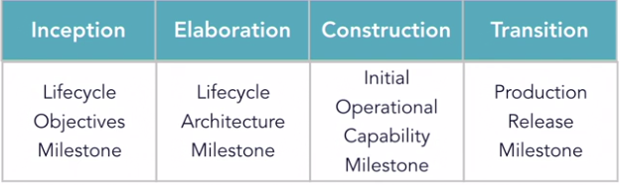
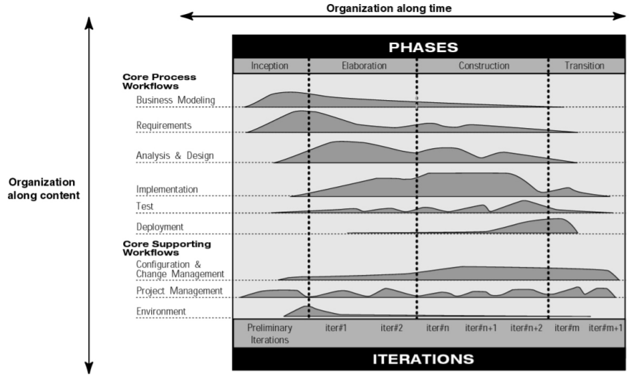
RUP Iterative Model
X-Axis: RUP Phases, Dynamic
Y-Axis: Organization Process, Static
Ref: Agile Software Development with Shashi Shekhar,LinkedIn Learning
30/8/22
S1-22_SEZG544 - Agile Software Process

Slide 44
Early Agile Models
Early Agile Methods
30/8/22
S1-22_SEZG544 - Agile Software Process

Slide 45
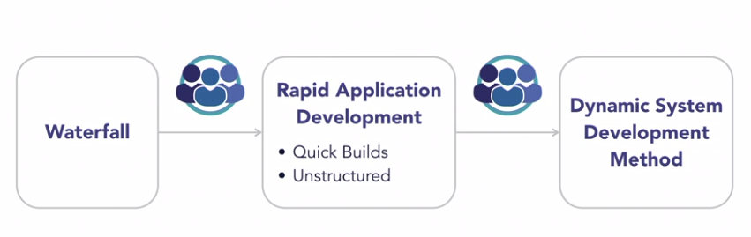
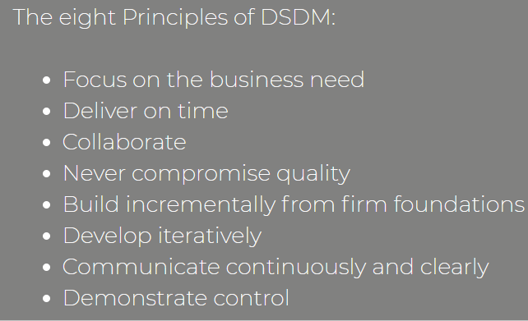
Dynamic System Development Method (DSDM)
Developed in 1994
Era where organization slowly moving away from waterfall model
During this time RAD model came into existence
RAD approach is very agile but has no formal process
DSDM was formed by group of organizations
Project development standard in Europe for several years
In 2016 DSDM is changed its name to Agile business consortium
https://www.agilebusiness.org/
Source:Agile Lynda.com, Agilebusiness.com
30/8/22
S1-22_SEZG544 - Agile Software Process

Slide 46
Feature Driven Development (FDD)
Lightweight Agile process
Software is a collection of features
Software feature =“working functionality with business value”
Deliver working software (working feature)
Short iterative process with five activities
Develop over all, Build Feature list, Plan by feature, Design by Feature Build by feature
FDD is used to build large banking systems successfully
Feature Example:
Calculate monthly interest on the account balance
(action) (result) (object)
Ref: Agile Software Development with Shashi Shekhar,LinkedIn Learning
30/8/22
S1-22_SEZG544 - Agile Software Process

Slide 47
Crystal Method- Selecting a Model
Life
Essential Money
Discretionary Money
Comfort
 | 1-6 | 7-20 | 21-40 | 41-80 | 81-200 | Large
Criticality
Team Size
Different crystal methodologies based on team size.
If Criticality increases tweak the process to address the extra risk
Comfort: System malfunction
Discretionary Money: Extra savings
Essential Money: Revenue loss
Life: Loss of life , Critical software
Crystal methods are people-centric, light-weight, and highly flexible. Focus on People, Interactions,Colloborations.
Developed by Alistair Cockburn , 1991
30/8/22
Ref: Agile Software Development with Shashi Shekhar,LinkedIn Learning
S1-22_SEZG544 - Agile Software Process

Slide 48
Thank you
30/8/22
S1-22_SEZG544 - Agile Software Process

